Slide 1
To start your game, on the Slide Show tab, select Play From Beginning.
Then tap SPIN and the spinner goes around
and tap it again to STOP.
Name the animal that the arrow shows.

Slide 2

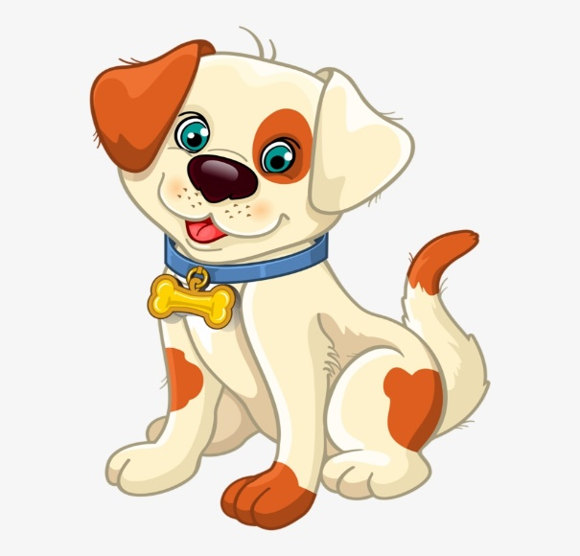
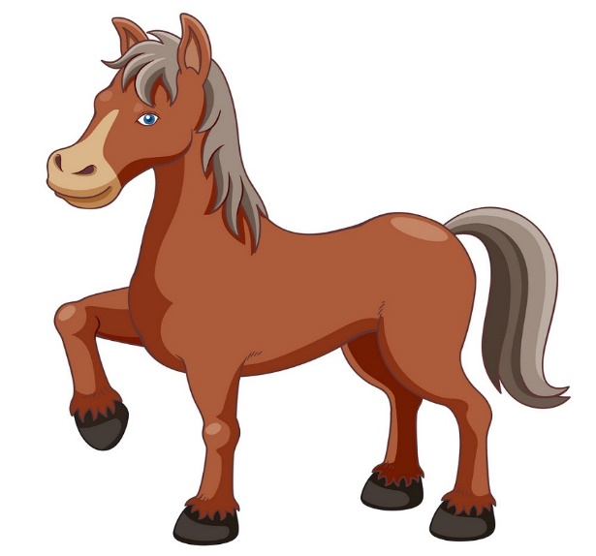


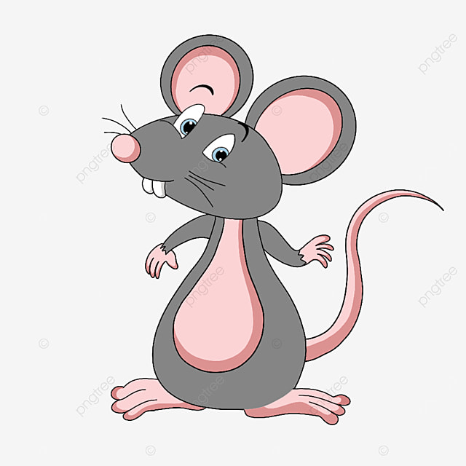

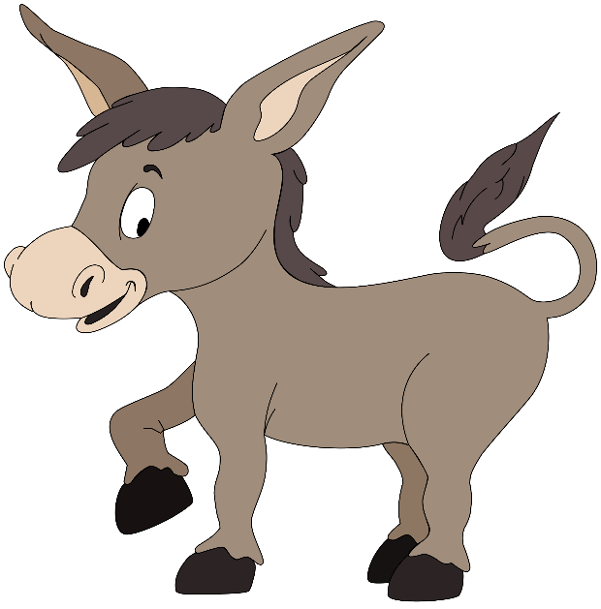

SPIN
tekhnologic
Notes:
7 Segments

